Slide 1

Graph Analyser
Xtai Lab

Slide 2

Agenda
Backend – Mamad 🙋🏻‍♂️
Frontend – Maryam 🙋🏻‍♀️
Frontend Improvement – Nada 🙋🏻‍♀️

Slide 3

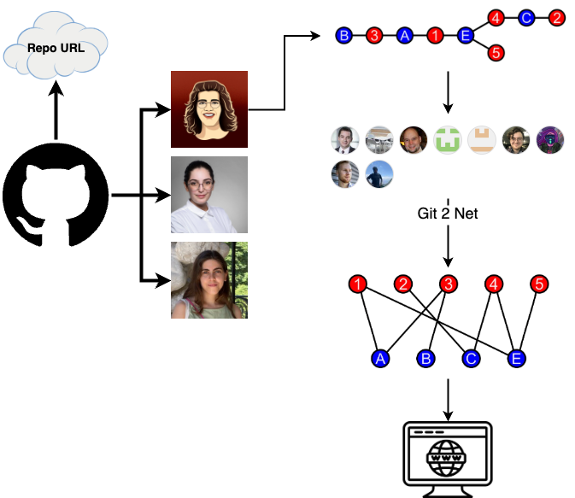
What is it even about?
Graphs from Repos

Slide 4
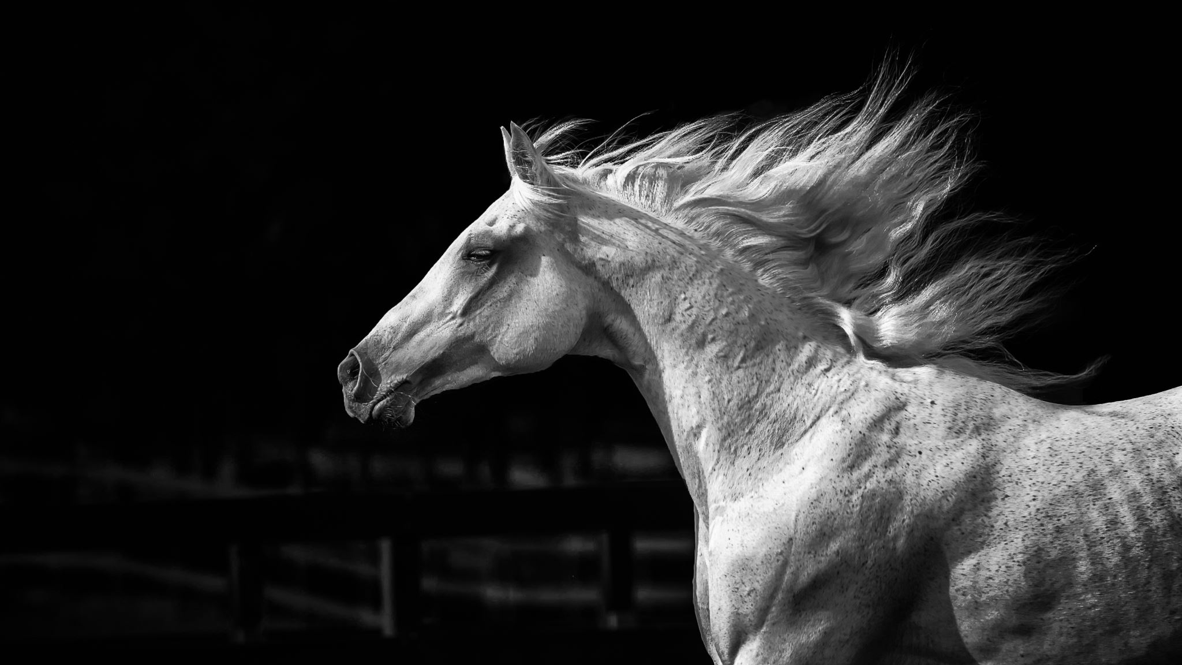
BACKend

Slide 5
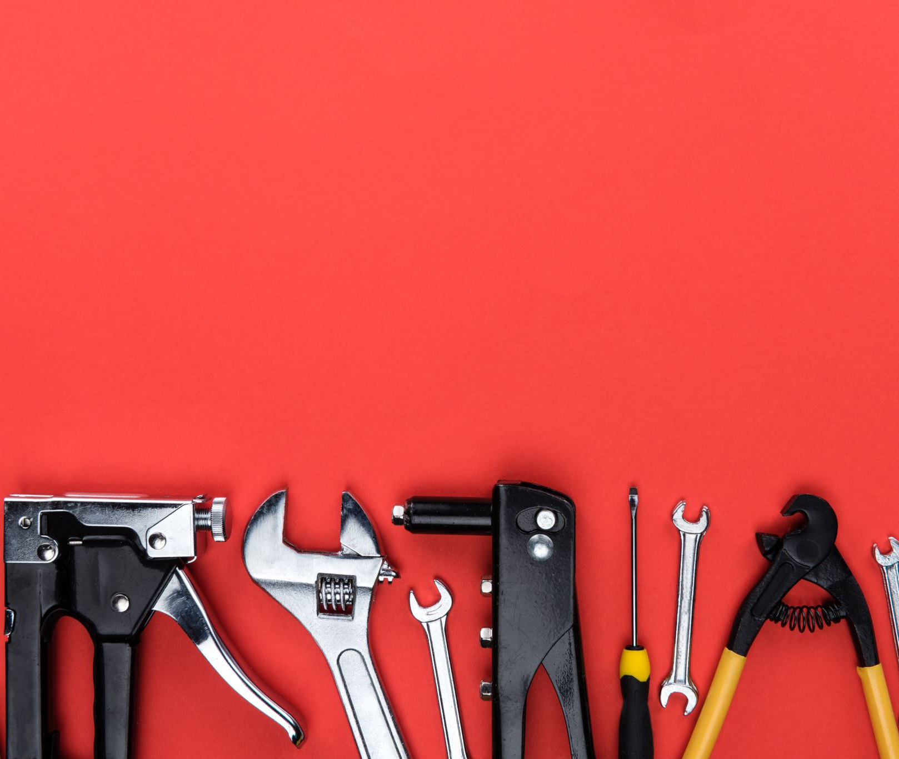
backend Core tools
Flask
Git2net
Pathpy

Slide 6


Slide 7
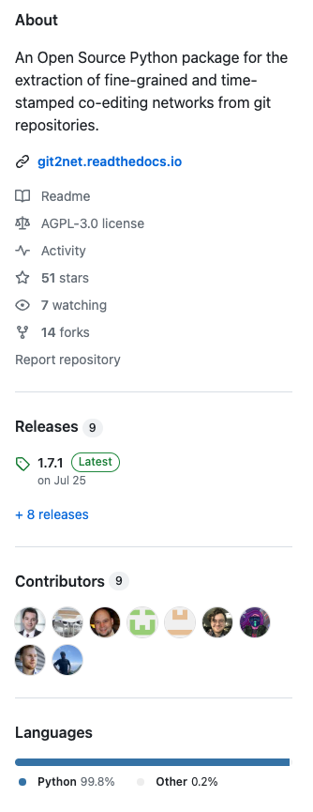
git2net

Slide 8
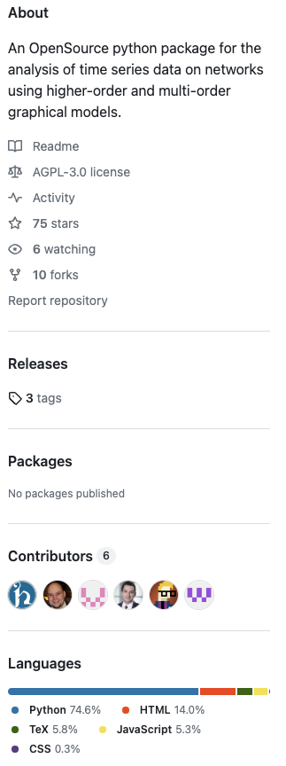
Pathpy

Slide 9
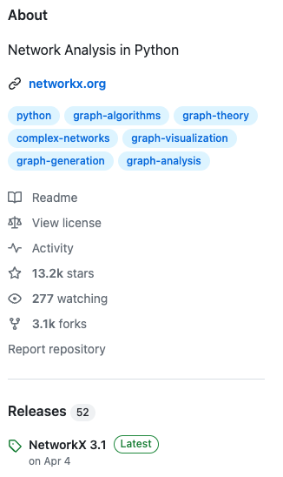

Networkx

Slide 10
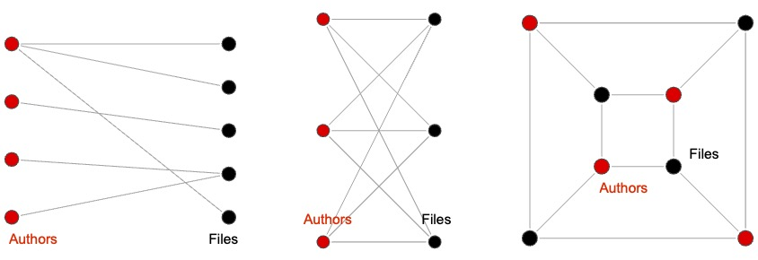
Bipartite graphs

Slide 11
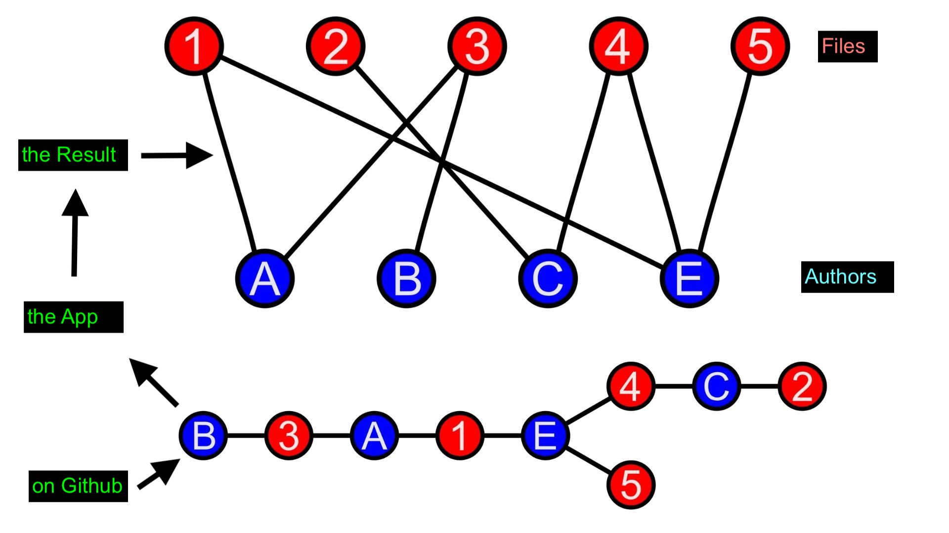
flowchart

Slide 12

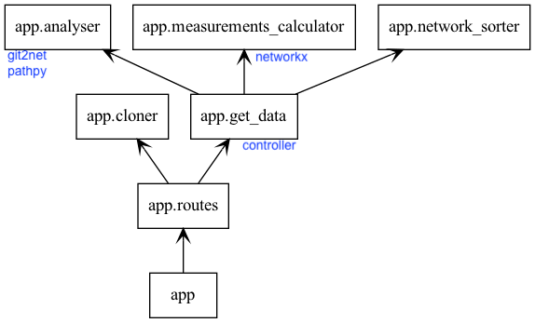
backend architecture
SRP, Clean Architecture and Open for Extension(Future Work)

Slide 13
Frontend

Slide 14
Frontend Improvement

Slide 15

Thanks for your attention!

